Slide 1

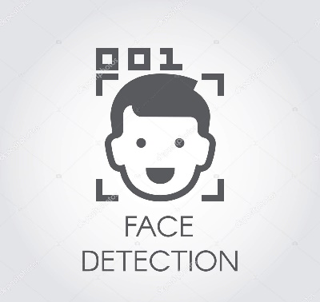
SKILL LAB PROJECT
SMART ATTENDANCE SYSTEM
FACE RECOGNITION (PYTHON)
http://www.free-powerpoint-templates-design.com

Slide 2
FACE DETECTION
Smart Attendance using Face Recognition
Face Detection has been one of the hottest
topic of computer vision for the past few years.This technology has been available for some years now and is being used all over the place.
It ensures fair attendance system and no
tampering of the recorded attendance can occur.
Capture
Matching
Result

Slide 3
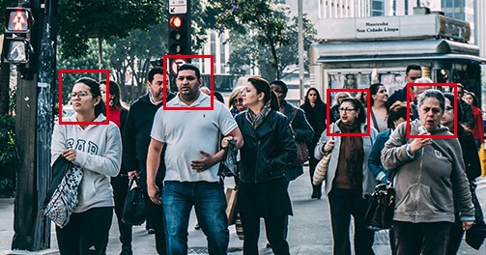
FACE RECOGNITION
The attendance issues are increasing day by day.May it be the fault of the teacher or the unknowing absence of the student,that causes faulty recordance of attendance.So keeping this in mind,we have decided to implement a real time face detection attendance system.

Slide 4
FEATURES
WELL DESIGNED
The Web page we have designed is simplicity at its best. It is not much complicated and can be easily used by teachers. The User Interface is designed in that manner.
MODULAR APPROACH
The System we have designed we have divided into sub modules, and not merely as a single file. This helps us in finding the errors, and working effectively.
APPROPRIATE PREDICTION
The prediction in our model by the use of opencv package gives
correct Prediction by the faces trained in the dataset and it reflects in the database
APPLICATION ORIENTED
We have not only designed a face detection system but also used its application to register the presence of a student in school.The school attendance system can be upgraded by our system

Slide 5
ADVANTAGES OF FACE RECOGNITION
Smart Attendance using Face Recognition
It reduces the Labour Cost Savings
It ensures automated Time tracking system.
Provides Tighter Security
To err is human but this efficient technique reduces the human error

Slide 6
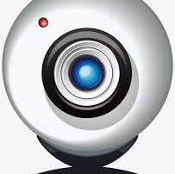

OBJECTIVE
OBJECTIVE OF OUR PROJECT
“
The main aspect of the project is to record the students attendance in a more concrete manner through face recognition. This will not only reduce the
burden of teachers but also it will ensure fair attendance by unique identity of
each person. The attendance is automatically uploaded to the web app and
displayed there. The teacher can access the web app to see the attendance record and manage it.
“
FACE RECOGNITION

Slide 7
CONCEPTS
USED IN THE PROJECT
Html / CSS
PYTHON
NUMPY
PILLOW
PYMYSQL
OPENCV

Slide 8
PROCEDURE
Smart Attendance System using Face Recognition
The system detects the face and displays the id .
The details get reflected in the web page
UPDATE
DATABASE
3
STUDENT
1
2
FACE DETECT
4
WEB
PAGE
Students need to scan their face in the system
The database is updated accordingly if he is present or absent

Slide 9
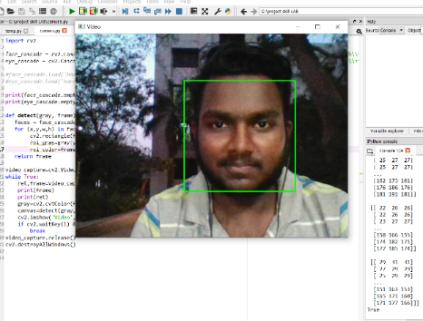


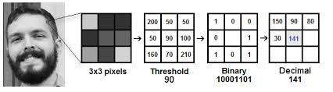
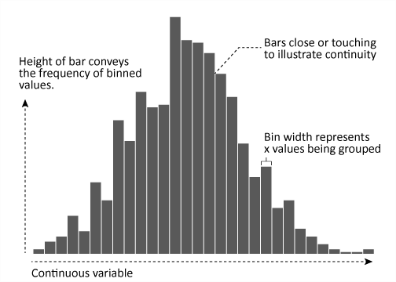


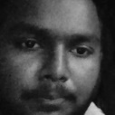
USES
Current Status
LOCAL BINARY
PATTERN HISTOGRAM
(LBPH)
The Working of our project :
SMART
ATTENDANCE
SYSTEM
It can be used in educational Institution
It can be used for Security Purposes.
It can be used to keep a track of the Voters while casting their vote
Keeping a Track of the employees in Corporate sectors.
USES
Video Capturing using Webcam
Face detection (enclosing a square ring around the face)
Creating a LOGIN PAGE
Getting a particular no. of images of each person(30 each)
Training the images matching with ids
First time Inputting necessary details and then video capturing
Saving the photos of the students and training the model
Predicting the name of the student and updating it in the database of the student
Local Binary Pattern (LBP) is a simple yet very efficient texture operator which labels the pixels of an image by thresholding the neighborhood of each pixel and considers the result as a binary number.
Then, we convert this binary value to a decimal value and set it to the central value of the matrix, which is actually a pixel from the original image.
As we have an image in grayscale, each histogram (from each grid) will contain only 256 positions (0~255) representing the occurrences of each pixel intensity.
Status
Working
Method
FACE
RECOGNITION
Database
(id,photo,rollno)

Slide 10


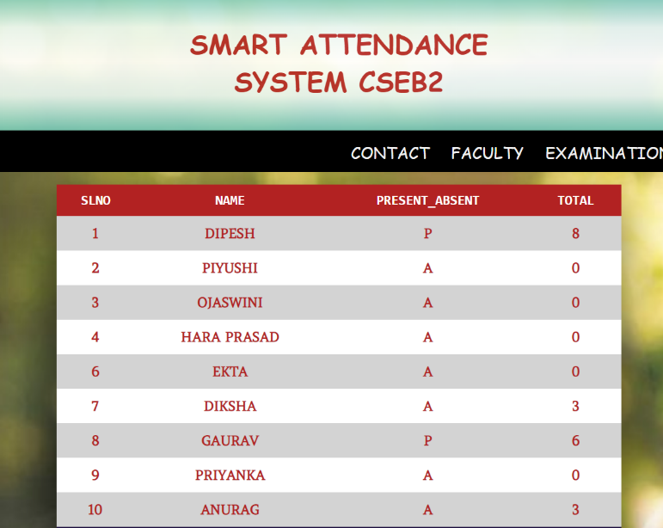
This we have have
implemented in reality
And the end result is
displayed in the web page
The Attendance gets
reflected
in the web page

Slide 11
Conclusion
With everything getting technologized, then why cannot attendance be recorded as smart as possible to minimize the human efforts.
The main aim is to pursue a mechanism of smart attendance through face recognition so that there is no room for flaws or any attendees left behind.
So have designed an efficient system through which the smart attendance agenda can be carried out, and there will be no workload on the teachers.
It can be applicable in every educational institutions to keep a track of students attending lectures.

Slide 12

DIPESH KUMAR SINGH
GAURAV MAHAPATRO
SUBHA SNIGDHA

